Slide 1
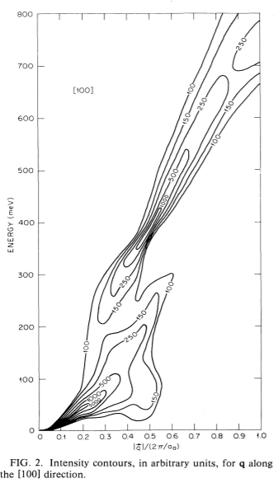
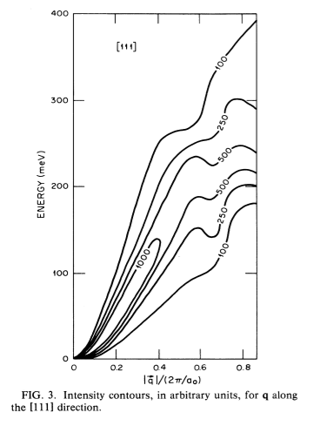
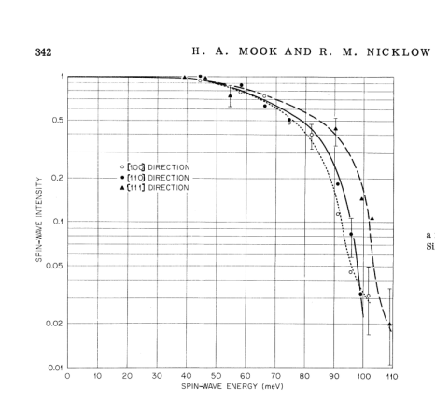
Spin wave excitations in Fe on the basis of band theory
Theory:
Experiment:
Blackman, J. A., Morgan, T. & Cooke, J. F. Prediction of High-Energy Spin-Wave Excitation in Iron. Phys. Rev. Lett. 55, 2814–2817 (1985).
Mook, H. A. & Nicklow, R. M. Neutron Scattering Investigation of the Magnetic Excitations in Iron. Phys. Rev. B 7, 336–342 (1973).

Slide 2
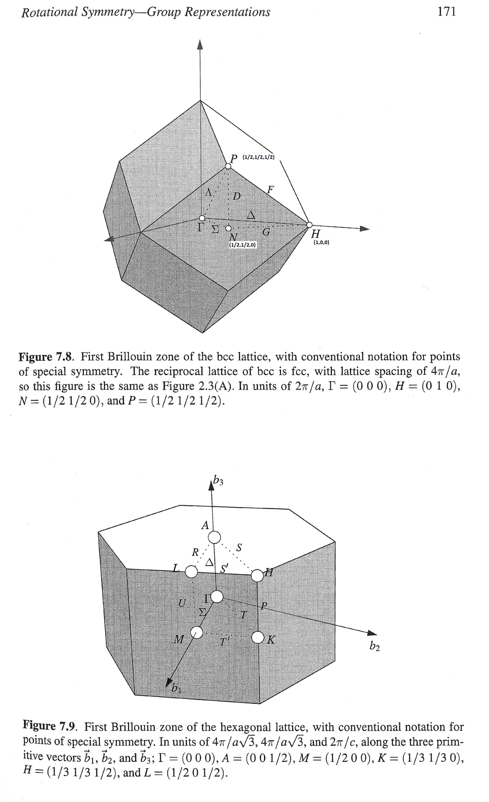
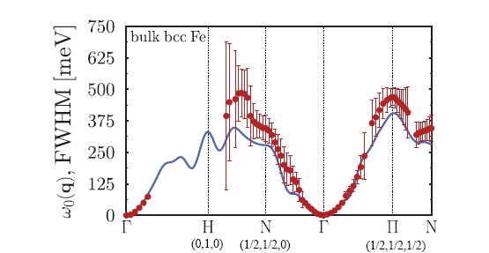
270
255
75

Slide 3
Looking for gap in 75-? mEv energy range
Exists:
Some vague pictures sowing evidence
Needed:
Better spherical cut
Resolution deconvolution
Symmetrisation

Slide 4
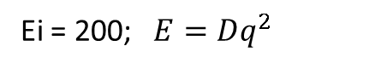
Ei = 200; $E=Dq^{2}$
Bragg 110, Directions [100] (ΓH), dE=2.5, dK=0.1
|D|=198 [meV*Α⁻²]
Bragg 1(-1)0, Directions [100] (ΓH), dE=2.5, dK=0.1
|D|=207 [meV*Α⁻²]
Bragg 200, Directions [100] (ΓH), dE=5, dK=0.1
|D|=230 [meV*Α⁻²]
dE=70-75, <±1,x,y> dK=0.2
dE=100-105, cut <0,x,y> dK=0.2
Gap

Slide 5
Looking for gaps in dispersion: Spherical Cut:

Slide 6
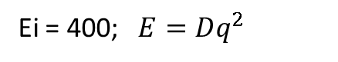
Ei=186 Bragg 200, Directions [100] (ΓH), dE=5, dK=0.1
|D|=237 [meV*Α⁻²]
Ei = 400; $E=Dq^{2}$
Bragg 110, Directions [100] (ΓH), dE=5, dK=0.1
|D|=237 [meV*Α⁻²]
Bragg 200, Directions [100] (ΓH), dE=5, dK=0.1
|D|=230 [meV*Α⁻²]
SW intersection observed at dE~250 in direction 200->3(-1)0?
Gap?

Slide 7
Searching for sw “Roof” at point “N” (1/2,1/2,0) at 250 mEV
Exists:
Pictures showing rooftop
Needed:
Q-dE cut

Slide 8
Catching N point (½, ½,0)
Ei=401
Ei=787
dE=200+20
dE=200+20
Ei=787
dE=220+20
dE=220+20
dE=220+20
dE=240+20
dE=240+20
dE=240+20
Π-no
- spur
dE=260+20
dE=260+20
G
dE=260+20
D?
dE=280+20
dE=280+20
dE=360+20
Ei=787
dE=300+20
dE=320+20
dE=340+20
Removed background

Slide 9
Symmetrized cuts:
Ei 400; 111 (u=[1,-1,1])

Slide 10
Ei 400; 111 (u=[1,-1,-1])

Slide 11
Peak [1,1,0], Heisenberg model:
With magFF
No magFF
Peak [1,1,0], Parabolic model:
With magFF
No magFF

Slide 12
Tobyfitting, parab model:
Peak [1,1,0]
FHHW+errors
SW amplitude + errors
Peak [1,1,0] direction [1,0,0]

Slide 13
Peak [2,0,0]

Slide 14
Peak [1,1,0], 2peaks approximation, parab SW:
FHHW+errors

Slide 15
Ei200 Peak [2,0,0], direction <111>
Ei400 Peak [1,1,0], direction <100>

Slide 16
Heisenberg model
Average J0 over number of cuts: 2.683324e+01, Error: 2.525307e-02

Slide 17
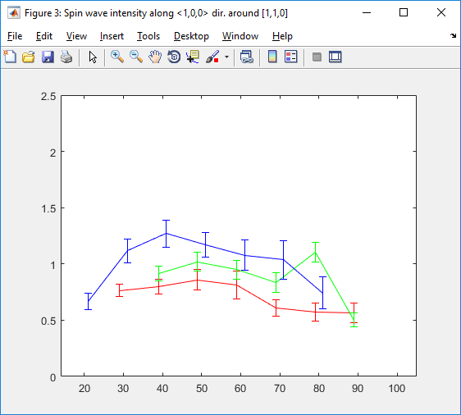
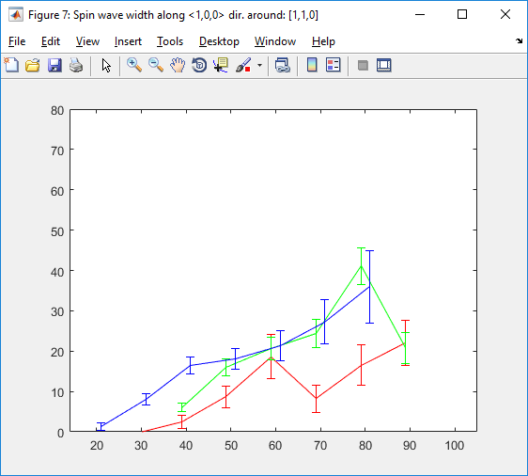
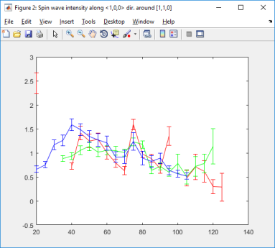
Peak [1,1,0],dir <100>, lattice 2.86 Heisenberg model fitting :
dE = 5.dk=0.1
Lifetime + errors
SW amplitude + errors
Peak [1,1,0],dir <100>, lattice 2.84 Heisenberg model fitting :
Cut: [1,1,0] Direction: [1,0,0] J : 29.6279 Sig: 0.097528; Direction: [0,1,0] J : 25.5337 Sig: 0.2565
Direction: [0,0,1] J : 25.3623 Sig: 0.24648
dE=10,dk=0.1
dE=10,dk=0.1, J1=26.8

Slide 18
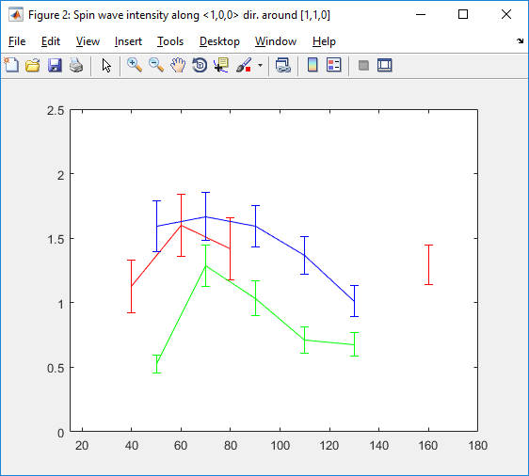
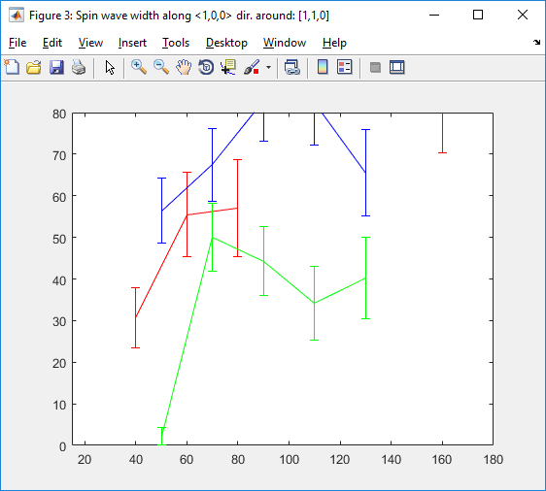
Peak [1,1,0], dir <1,0,0> Heisenberg model, Ei=400:
SW amplitude + errors
SW amplitude + errors (realigned a=2.84)
Lifetime errors
Lifetime (realigned)
dE=20, dk=0.1
Cut: [1,1,0] Direction: [1,0,0] J : 28.8519 Sig: 0.58639; Cut: [1,1,0] Direction: [0,0,1] J : 31.3937 Sig: 1.4618
Cut: [1,1,0] Direction: [0,1,0] J : 33.7659 Sig: 1.0776

Slide 19
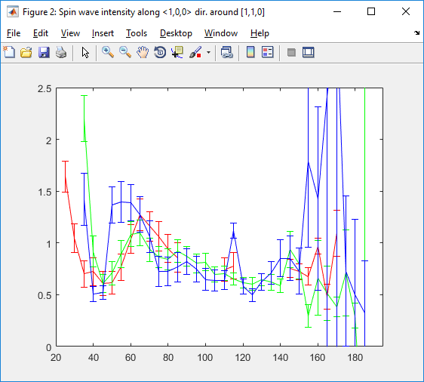
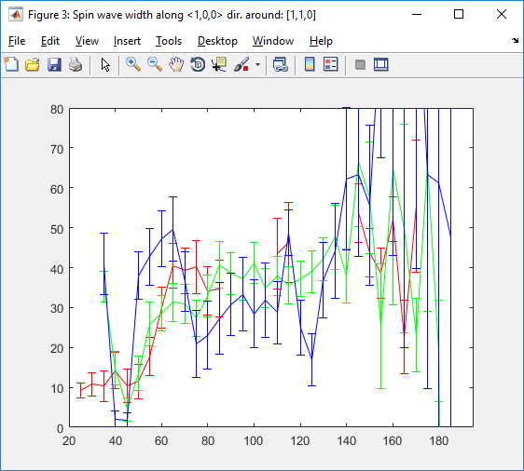
Peak [1,1,0],dir <100>, Ei400 J0= 25.29; J1 = 13.9312;
J2 = -3.0125; fixed

Slide 20
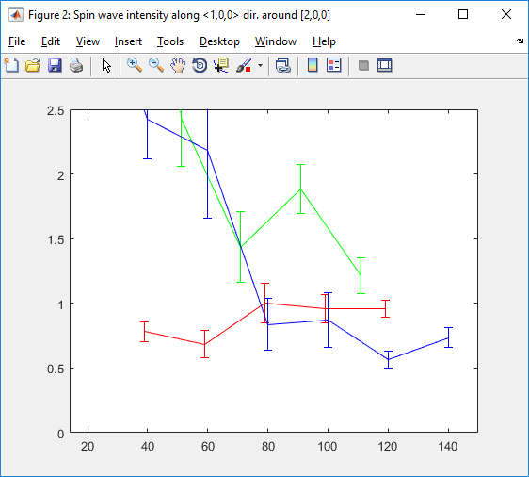
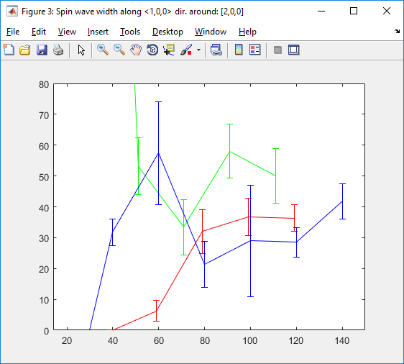
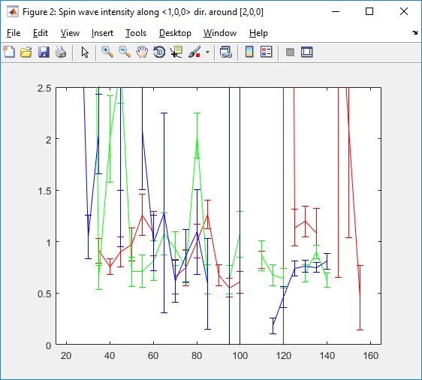
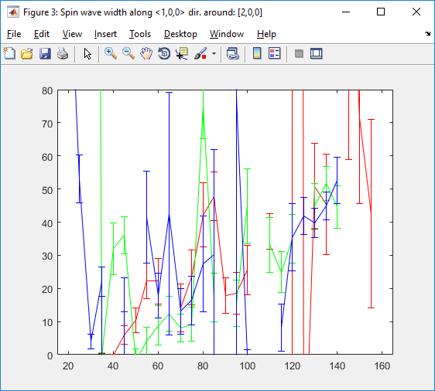
Peak [2,0,0],dir <100>, lattice 2.84 Heisenberg model fitting :
dE = 20,dk=0.1
Cut: [2,0,0] Direction: [1,0,0] J : 28.435 Sig: 0.24594
Cut: [2,0,0] Direction: [0,1,0] J : 29.7391 Sig: 0.96891
Cut: [2,0,0] Direction: [0,0,1] J : 29.9298 Sig: 0.52267
dE = 10,dk=0.1
Cut: [2,0,0] Direction: [1,0,0] J : 28.6375 Sig: 0.62427
Cut: [2,0,0] Direction: [0,1,0] J : 30.3907 Sig: 0.8239
Cut: [2,0,0] Direction: [0,0,1] J : 29.6234 Sig: 0.59638

Slide 21
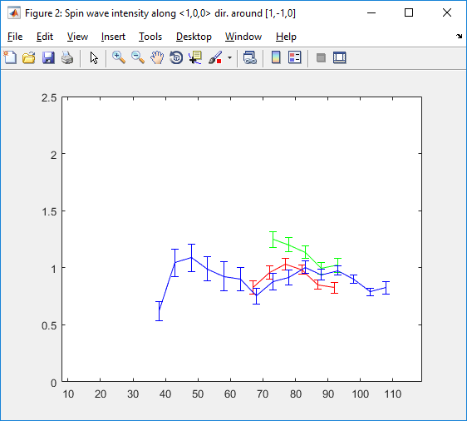
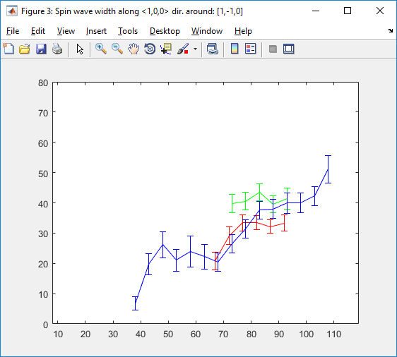
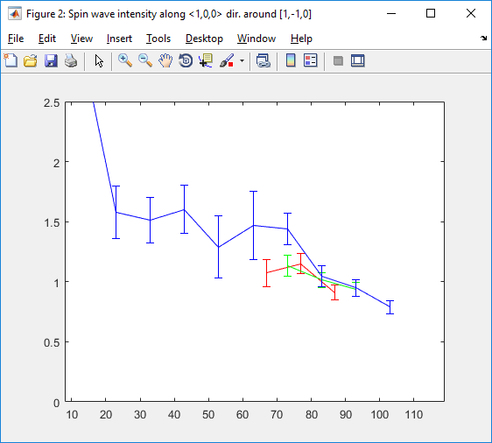
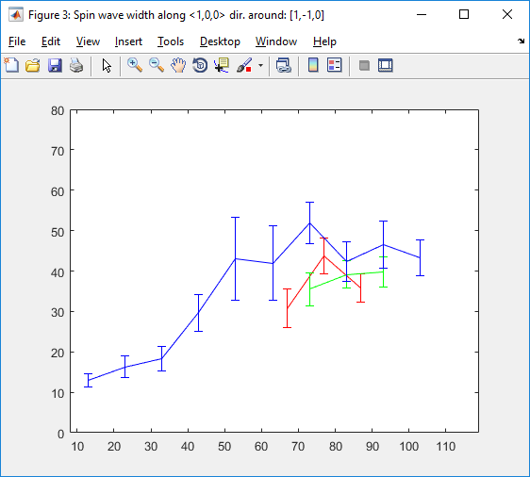
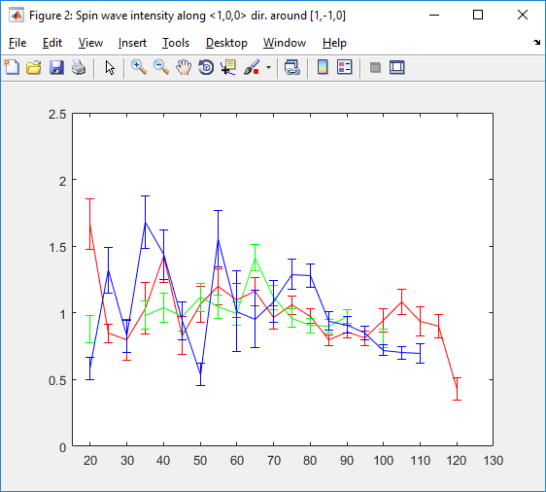
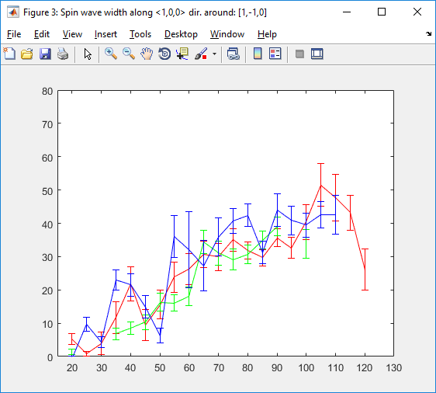
Peak [1,-1,0],dir <100>, lattice 2.84 Heisenberg model fitting :
dE = 5,dk=0.2
Cut: [1,-1,0] Direction: [1,0,0] J : 28.0905 Sig: 0.22103
Cut: [1,-1,0] Direction: [0,1,0] J : 28.8345 Sig: 0.31611
Cut: [1,-1,0] Direction: [0,0,1] J : 28.0218 Sig: 0.19771
dE = 10,dk=0.1
Cut: [1,-1,0] Direction: [1,0,0] J : 28.0275 Sig: 0.47043
Cut: [1,-1,0] Direction: [0,1,0] J : 28.2609 Sig: 0.39878
Cut: [1,-1,0] Direction: [0,0,1] J : 28.1609 Sig: 0.46733
dE = 10,dk=0.1, J=28.6 (fixed)

Slide 22
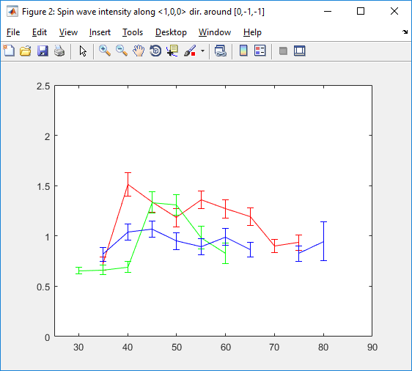
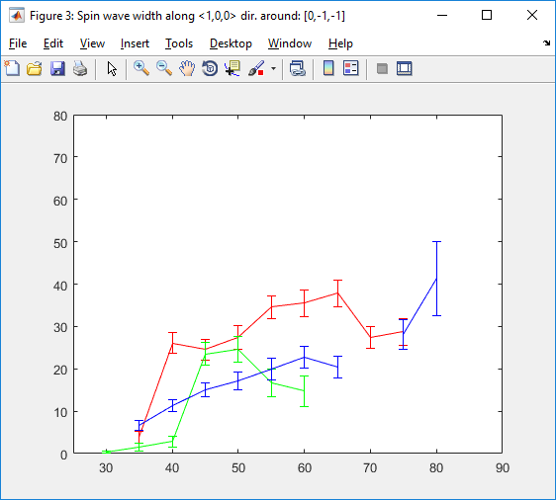
Peak [0,-1,-1],dir <100>, lattice 2.84 Heisenberg model fitting :
dE = 10,dk=0.1, J=28.6 (fixed)

Slide 23
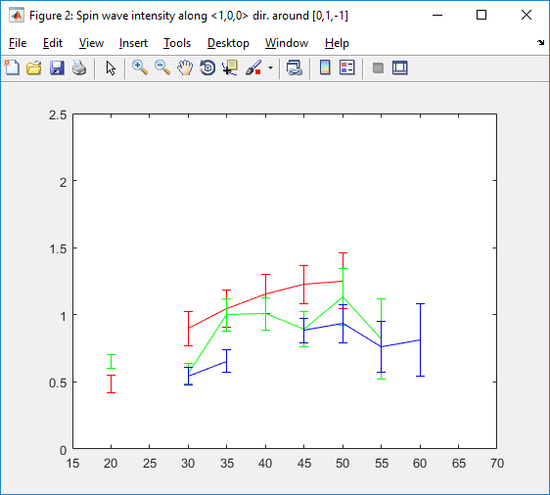
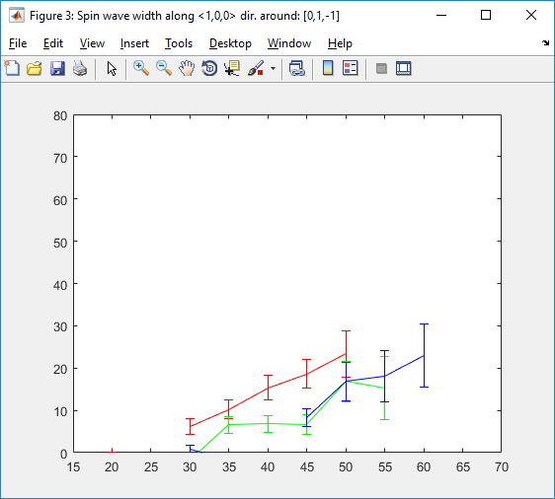
Peak [0,1,-1],dir <100>, lattice 2.84 Heisenberg model fitting :
dE = 10,dk=0.1, J=28.6 (fixed)

Slide 24
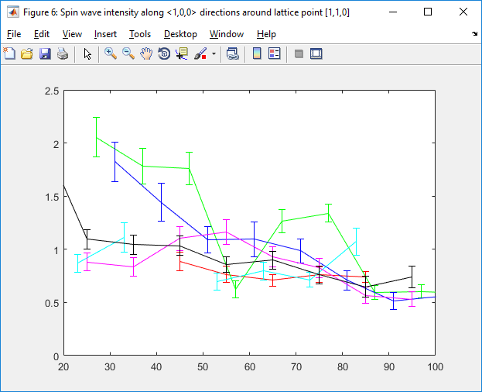
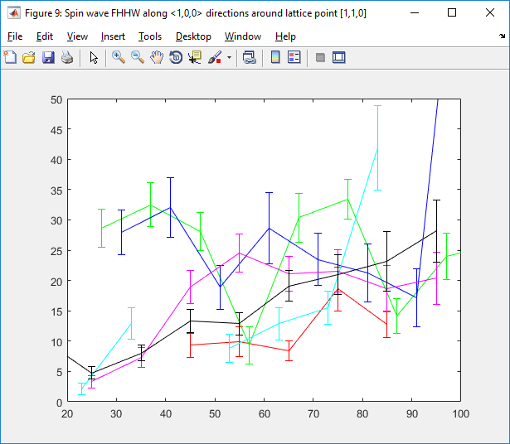
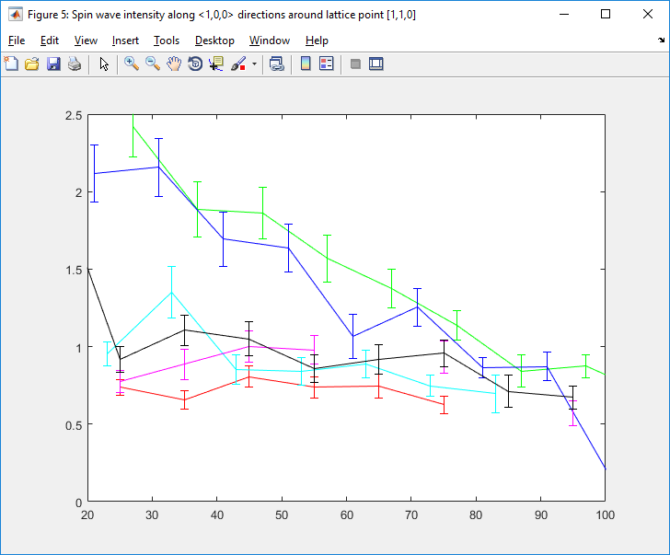
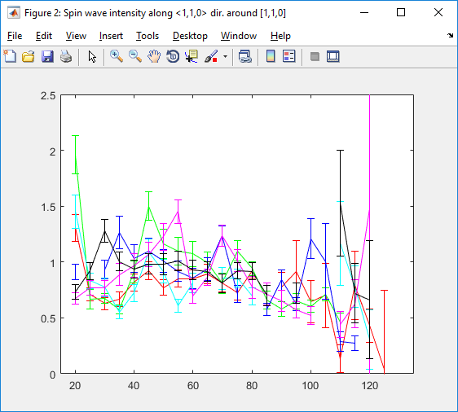
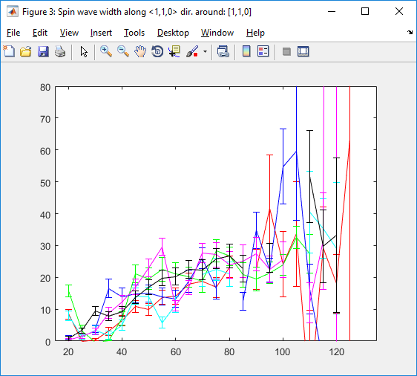
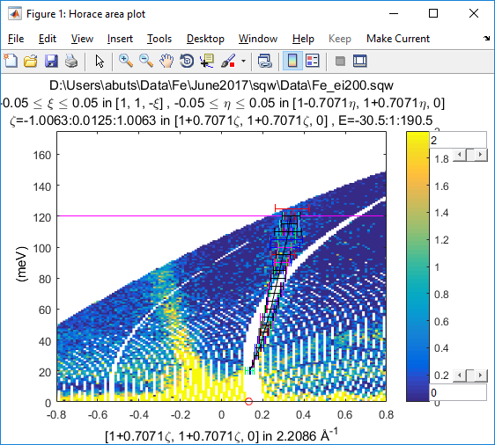
Peak [1,1,0], dir <1,1,0> Heisenberg model, Ei=200:
Realigned:
dE=10,dK=0.1 J0=28.6 fix

Slide 25
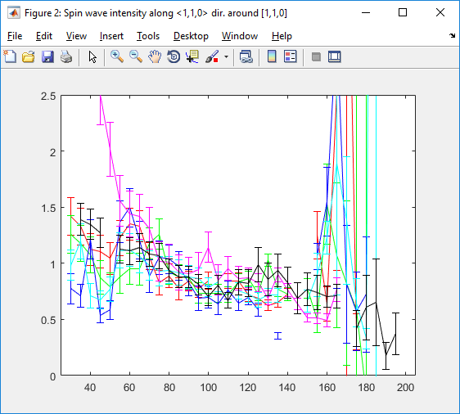
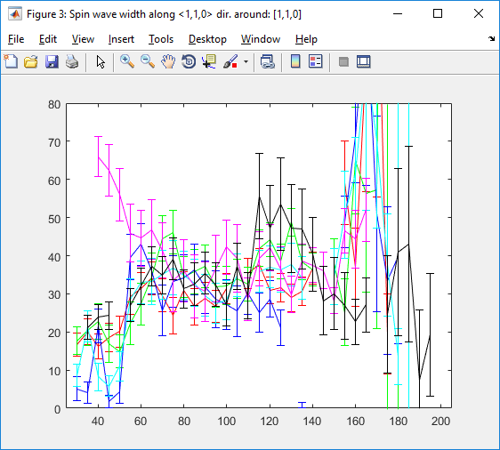
Peak [1,1,0], dir <1,1,0> Ei=400, J0= 25.29; J1 = 13.9312;
J2 = -3.0125; fixed

Slide 26
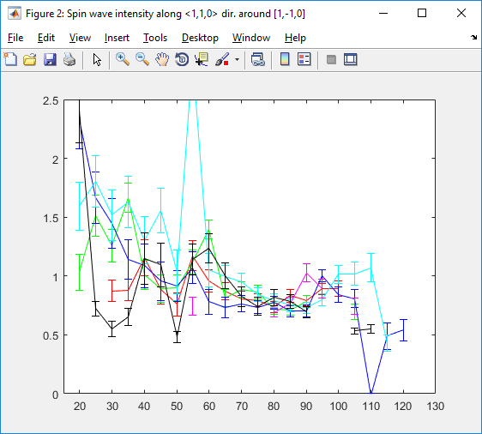
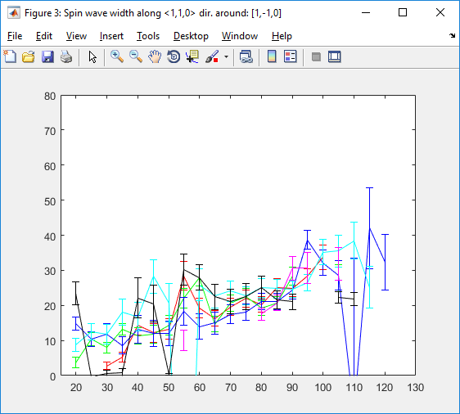
Peak [1,-1,0], dir <1,1,0> Heisenberg model, Ei=200:
dE=10,dK=0.1 J0=28.6 fix

Slide 27
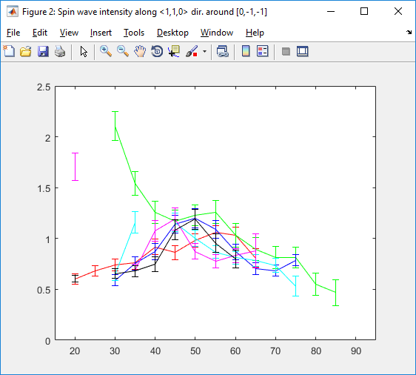
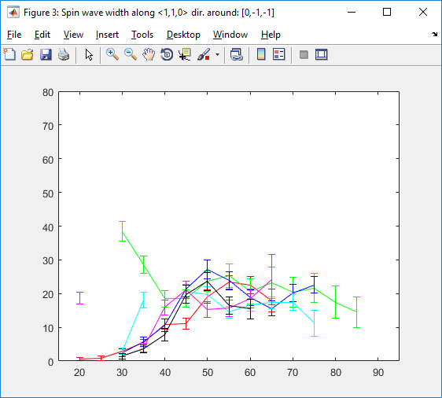
Peak [0,-1,-1], dir <1,1,0> Heisenberg model, Ei=200:
dE=10,dK=0.1 J0=28.6 fix

Slide 28
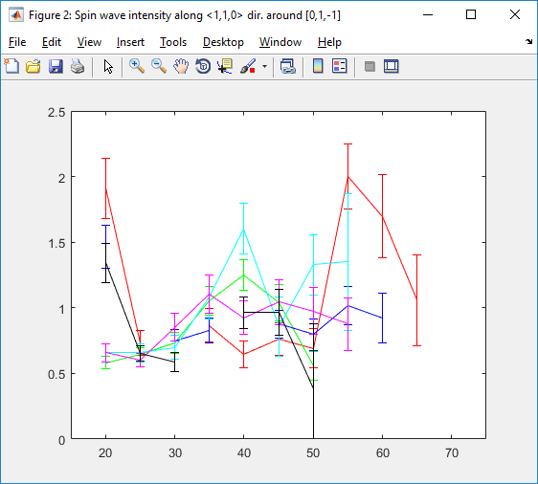
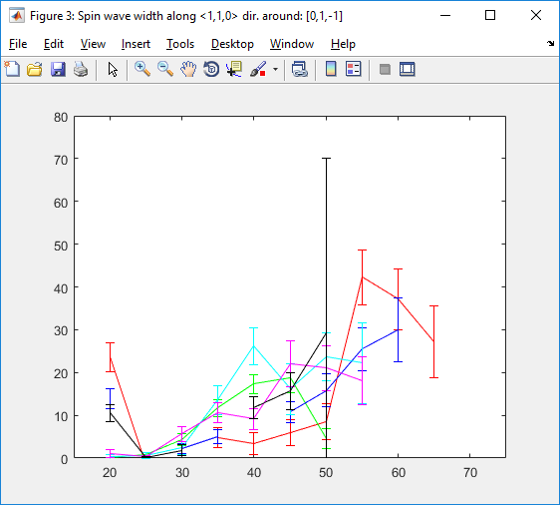
Peak [0,1,-1], dir <1,1,0> Heisenberg model, Ei=200:
dE=10,dK=0.1 J0=28.6 fix

Slide 29
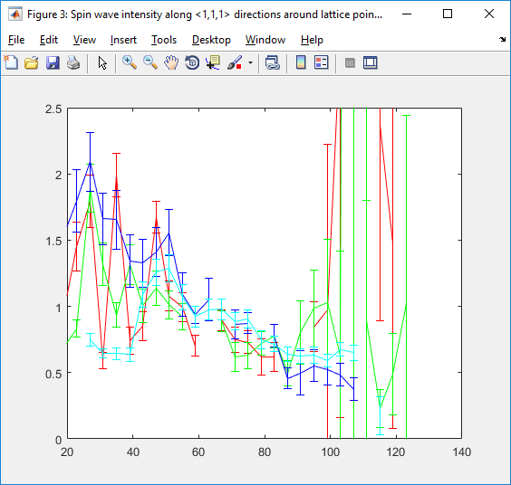
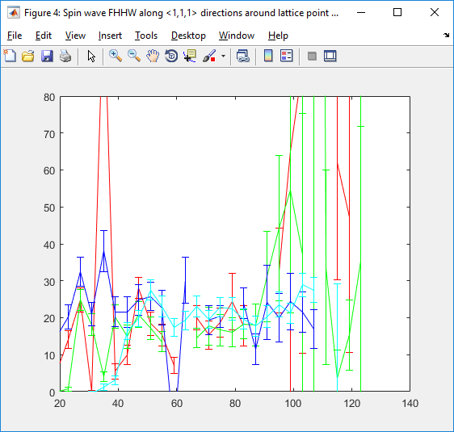
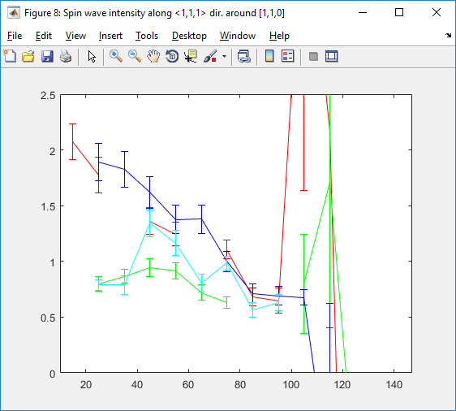
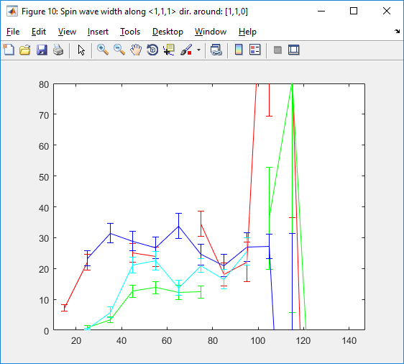
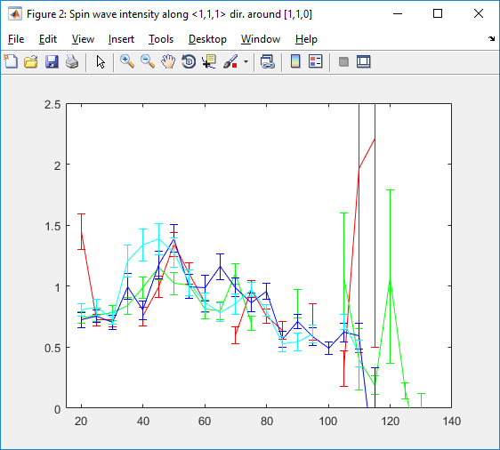
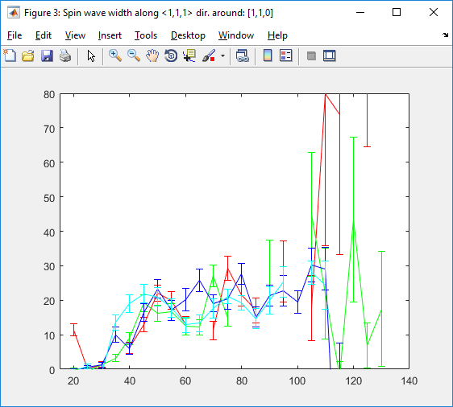
Peak [1,1,0], dir <1,1,1> Heisenberg model, Ei=200:
Cut: [1,1,0] Direction: [1,1,1] J : 26.0365 Sig: 0.077748; Cut: [1,1,0] Direction: [1,-1,1] J : 27.7654 Sig: 0.13421
Cut: [1,1,0] Direction: [1,-1,-1] J : 27.9709 Sig: 0.27515; Cut: [1,1,0] Direction: [1,1,-1] J : 27.2034 Sig: 0.071099
Realigned, dE = 4:
dE=10
dE=10,dK=0.1; J=28.6 fixed

Slide 30
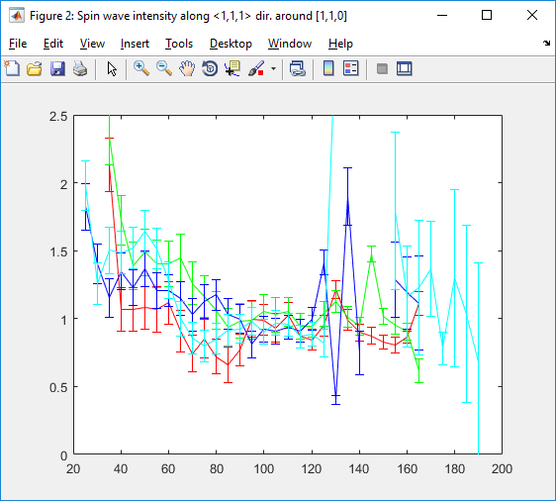
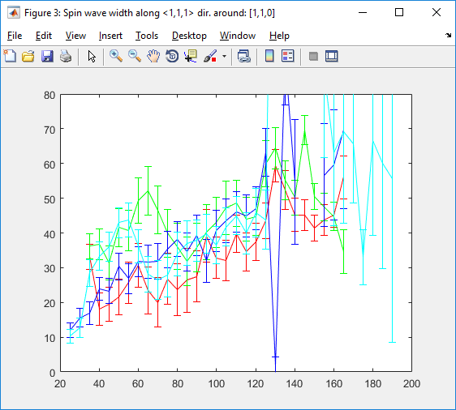
Peak [1,1,0], dir <1,1,1>, Ei=400: J0= 25.29; J1 = 13.9312;
J2 = -3.0125; fixed

Slide 31


Peak [1,-1,0], dir <1,1,1> Heisenberg model, Ei=200:

Slide 32


Peak [2,0,0], dir <1,1,1> Heisenberg model, Ei=200:

Slide 33


Peak [0,-1,-1], dir <1,1,1> Heisenberg model, Ei=200:

Slide 34


Peak [0,1,-1], dir <1,1,1> Heisenberg model, Ei=200:

Slide 35










Summary over Braggs, Ei=200, J0=26.8;
[1,1,0]
[1,-1,0]
[1,1,0] & [1,-1,0]
[2,0,0]

Slide 36


All <100>, Ei=200; J0 only

Slide 37




All dir, Ei200 J:0-2
Bragg [110]; J0-J2
j0: 27.06 +/- 0.04; j1: 12.34 +/- 0.038; j2: -3.76 +/- 0.013
All Braggs J0-J2:
J0: 24.915 +/- 0.02; J1: 13.760 +/- 0.02; J2: -3.236 +/- 0.004
J0: 28.146 +/- 0.068; J1: 12.931 +/- 0.064; J2: -4.232 +/- 0.020

Slide 38




Bragg [1,-1,0] J0: 11.563 +/- 0.703; J1: 40.951 +/- 0.146; J2: 3.730 +/- 0.190 J3: -4.841 +/- 0.017 ; J4: 1.647 +/- 0.067
All Braggs
J0: 9.957 +/- 0.033; J1: 40.226 +/- 0.061; J2: 2.873 +/- 0.007
J3: -4.596 +/- 0.006 J4: 2.378 +/- 0.004

Slide 39




Ei400, [1-1 0] J0: 17.428 +/- 1.898; J1: 33.032 +/- 1.574; J2: 17.804 +/- 0.304 J3: -7.854 +/- 0.100 J4: -4.879 +/- 0.351
Ei400 [1,1,0]
J0: 10.076 +/- 1.216; J1: 30.758 +/- 1.232;
J2: 15.712 +/- 0.692
J3: -6.723 +/- 0.272 J4: -1.975 +/- 0.358

Slide 40
Ei400, [2 0 0] J0:

Slide 41




Peak [1,1,0], dir <1,1,0> Heisenberg model, Ei=400:
dE=10;dk=0.1
Cut: [1,1,0] Direction: [1,1,0] J : 29.4 Sig: 0.58039; Cut: [1,1,0] Direction: [1,-1,0] J : 34.4599 Sig: 0.3922
Cut: [1,1,0] Direction: [1,0,1] J : 33.5446 Sig: 0.613; Cut: [1,1,0] Direction: [1,0,-1] J : 30.6759 Sig: 0.378
Cut: [1,1,0] Direction: [0,1,1] J : 34.3693 Sig: 0.588; Cut: [1,1,0] Direction: [0,1,-1] J : 34.0474 Sig: 0.410
dE=20;dk=0.1
Cut: [1,1,0] Direction: [1,1,0] J : 33.6079 Sig: 1.3986; [1,-1,0] J : 34.0755 Sig: 0.72275
[1,0,1] J : 32.4547 Sig: 0.667; [1,0,-1] J : 30.9517 Sig: 0.39285
[0,1,1] J : 35.183 Sig: 0.84968; [0,1,-1] J : 34.2541 Sig: 0.45708

Slide 42


Peak [1,1,0], dir <1,1,1> Heisenberg model, Ei=400:
dE=20;dk=0.1
Cut: [1,1,0] Direction: [1,1,1] J : 34.8783 Sig: 0.95814; Cut: [1,1,0] Direction: [1,-1,1] J : 34.6438 Sig: 0.42422
Cut: [1,1,0] Direction: [-1,1,1] J : 34.5406 Sig: 0.49859; Cut: [1,1,0] Direction: [1,-1,-1] J : 35.5887 Sig: 0.4593

Slide 43




Peak [1,-1,0], dir <1,0,0> Heisenberg model, Ei=787:
Cut: [1,-1,0] Direction: [1,0,0] J : 27.6552 Sig: 1.2569; Cut: [1,-1,0] Direction: [0,1,0] J : 30.4969 Sig: 0.56687
Cut: [1,-1,0] Direction: [0,0,1] J : 35.9077 Sig: 0.66817
Peak [1,-1,0], dir <1,1,0> Heisenberg model, Ei=787:
Cut: [1,-1,0] Direction: [1,1,0] J : 30.1267 Sig: 0.95236; Cut: [1,-1,0] Direction: [1,-1,0] J : 35.4225 Sig: 1.4114
Cut: [1,-1,0] Direction: [1,0,1] J : 30.914 Sig: 0.78239; Cut: [1,-1,0] Direction: [1,0,-1] J : 35.2996 Sig: 1.3725
Cut: [1,-1,0] Direction: [0,1,-1] J : 34.9945 Sig: 0.52071

Slide 44
Equivalent direction fits

Slide 45


[1,-1,0] fitting with J0
Ei45
Ei65

Slide 46
[1-1 0]
Ei200 fit with J from Ei400 fit

Slide 47
[1 1 0]
J0-2

Slide 48
Energy dependent misalignment?

Slide 49
Realigned Fe401:
Old:
New:

Slide 50
Realigned Fe200:
Old:
New:

Slide 51
J0: 9.957 +/- 0.033; J1: 40.226 +/- 0.061; J2: 2.873 +/- 0.007
J3: -4.596 +/- 0.006 J4: 2.378 +/- 0.004

Slide 53

Fitting with changeable J0 Braggs [110],[1-10] and [200]

Slide 54
Q-cuts:
1) J-variable

Slide 55
DFT comparison:
Fitting dispersion in 100 direction using Gaussian function.
Fitting range 0-2 (in hkl)
Ei=10
Ei=50
Ei=92
Ei=147
Ei=201
Ei=297

Slide 56
DFT comparison:
Fitting dispersion in 100 direction using DSHO function.
Fitting range 0-2 (in hkl), no MagFF.
Ei=10
Ei=51
Ei=92
Ei=147
Ei=201
Ei=297

Slide 57
DFT comparison:
Fitting dispersion in 100 direction using 800mEv resolution convoluted DSHO function. Fitting range 1-3 (in hkl), no MagFF applied
red line – resolution convoluted DSHO fitting.
green line – non-convoluted DSHO
Ei=10
Ei=50
Ei=90
Ei=150
Ei=180
Ei=210
black/red – resolution convoluted (RC) DFT/fit;
blue/green – non RC DFT/fit used as source for black/red

Slide 58
DFT comparison:
Fitting dispersion in 100 direction using 400mEv resolution convoluted DSHO function. Fitting range 1-3 (in hkl), no MagFF applied
red line – resolution convoluted DSHO fitting.
green line – non-convoluted DSHO
Ei=10
Ei=51
Ei=92
Ei=148
Ei=`179
Ei=210
black/red – resolution convoluted (RC) DFT/fit;
blue/green – non RC DFT/fit used as source for black/red

Slide 59
Resolution conv vs non-convoluted:
Resolution: 800mEv
Resolution: 400mEv
red line – resolution convoluted DSHO fitting.
green line – non-convoluted DSHO

